Slide 1
Mount House School Baking Booklet Summer Term

Slide 2
DATES
Week 1: planning traditional dish (w/c 15.04.2024)
Week 2: chocolate Viennese swirls (w/c 22.04.2024)
Week 3: Curly Wurly raspberry bake (w/c 29.04.2024)
Week 4: berry crumble pots (w/c 06.05.2024)
Week 5: quick strawberry mousse (w/c 13.05.2024)
Week 6: prepare/bake traditional bake (w/c 20.05.2024)

Slide 3
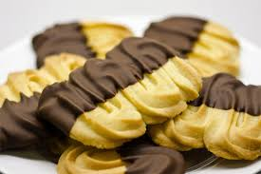
INGREDIENTS
125g unsalted butter, softened
25g unrefined golden icing sugar
1 tsp vanilla extract (school to provide)
125g plain flour
25g cornflour
150g milk chocolate, melted
Optional sprinkles/dried fruit
Chocolate Viennese whirls

Slide 4
Method
STEP 1
Heat the oven to 190°C/170°C fan/gas 5.
Beat the butter, icing sugar and vanilla extract in a mixing bowl.
Stir in the flour and cornflour using a wooden spoon until fully combined.
STEP 2
Spoon the biscuit dough into the piping bag, then pipe about 8 swirly biscuits (any shape or letters that you fancy) onto the lined baking sheets, leaving room for them to spread a little during baking. Bake for 8-10 minutes until pale golden. The swirls will still be soft but will harden as they cool.
STEP 3
Once cool, gently dip half of each biscuit in the melted chocolate, (or sprinkles as you prefer).

Slide 5
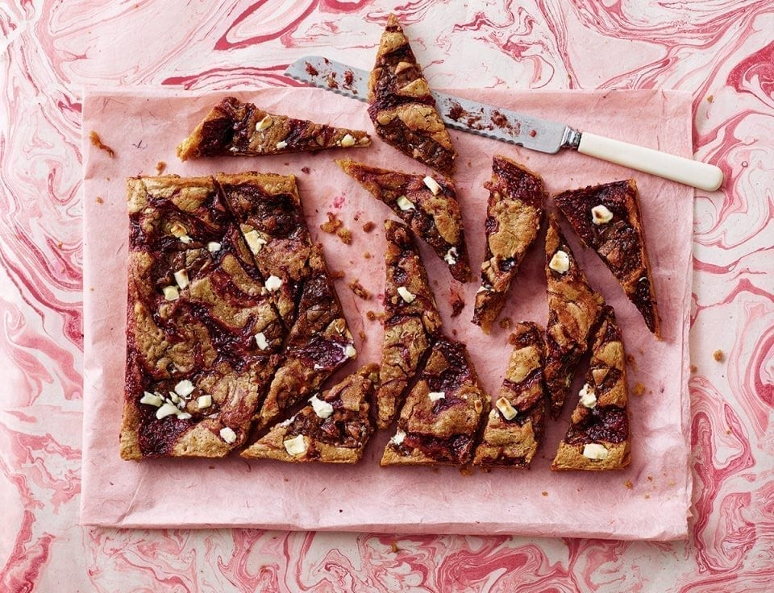
Curly Wurly Raspberry Bake
INGREDIENTS
250g plain flour
1½ tsp baking powder (school to provide)
½ tsp salt (school to provide)
200g unsalted butter, melted
250g light brown sugar
3 medium free-range eggs, beaten
1 tsp vanilla bean extract (school to provide0
120g Milkybars, roughly chopped
3 Curly Wurly bars, roughly chopped
200g frozen raspberries, defrosted
40g caster sugar
Squeeze fresh lemon juice

Slide 6
Method
STEP 1
Heat the oven to 170°C/150°C fan/gas 3½. For the raspberry sauce, put the raspberries into a saucepan with the sugar and lemon juice and heat gently for 5-10 minutes until the berries have broken down. Pour into a bowl and set aside to cool.
STEP 2
Sift the flour, baking powder and salt into a bowl. In another mixing bowl, beat the butter, sugar, eggs and vanilla with a wooden spoon.
STEP 3
Using a large metal spoon, gently fold the flour mixture into the egg mixture, fold in the Milkybar pieces, then pour into the lined roasting tin. Swirl through the raspberry sauce with a skewer, then poke in the pieces of Curly Wurly.
STEP 4
Bake for 22-25 minutes until the top has a thick crust and the middle feels squidgy but still holds its shape.

Slide 7
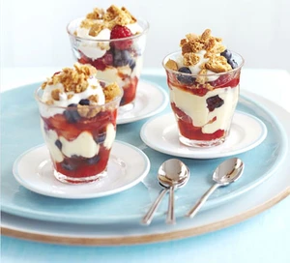
Berry crumble pots
INGREDIENTS
2 tbsp good-quality strawberry jam
juice 2 clementines or satsumas
300g mixed berries
150ml fresh custard
4 tbsp double cream, lightly whipped (or use crème fraîche or Greek yogurt if you prefer)

Slide 8
Method
STEP 1
Mix the jam and citrus juice together in a bowl.
Stir in the berries. Divide half the berries between 4 glasses or small bowls.
Top with the custard, the rest of the berries and finally the cream.
Crumble over the biscuits and serve.

Slide 9
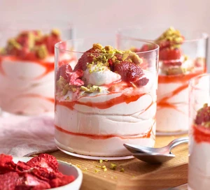
Quick strawberry mousse
INGREDIENTS
500g strawberries, hulled and halved, any larger ones quartered
1 lemon, zested and juiced
100g caster sugar
150ml mascarpone
300ml double cream
1 tbsp vanilla extract (school to provide)
To serve
4 gingernut biscuits, crushed
freeze-dried strawberries, crushed (optional)

Slide 10
METHOD
STEP 1
Put the strawberries, lemon juice, sugar and 2 tbsp water in a large pan over a medium heat and cook for 5 mins until the fruit has softened. Scrape into a bowl leave to cool. Tip 300g of the mixture into a blender (reserve the rest for later), blitz until smooth and sieve into a jug.
STEP 2
Whisk the mascarpone in a large bowl to soften, then add the double cream, vanilla extract and lemon zest, and whisk again until just starting to thicken. Fold in the blitzed, sieved strawberry purée to combine – it will thicken a bit more. Alternatively, swirl it through so you have layers of compote going through the mousse.
STEP 3
Spoon the mousse into glass tumblers and top with the reserved strawberry compote, the gingernut crumbs AND dried strawberries, if you like.

